Slide 1
Matter as a Wave

Slide 2
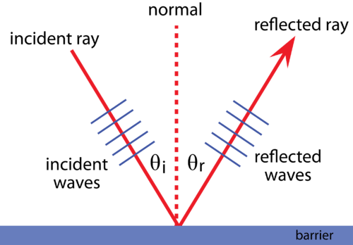
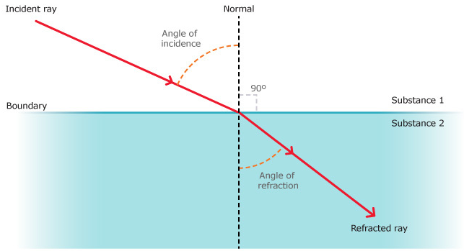
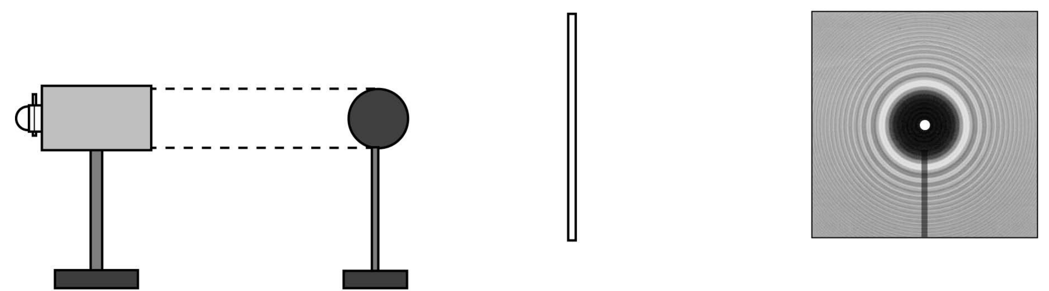
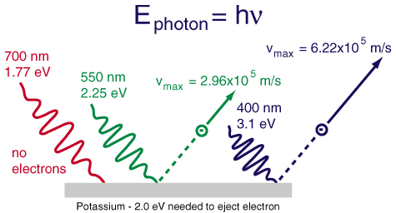
Wave-Particle Duality Review
We have already seen that the wave nature of light explains a number of phenomena very well:
Reflection
Refraction
Diffraction
Interference
Polarisation
However, it fails to explain the photoelectric effect, which is much better explained by considering light as a particle.
“We have two contradictory pictures of reality; separately neither of them fully explains the phenomena of light, but together they do.” – Albert Einstein

Slide 3
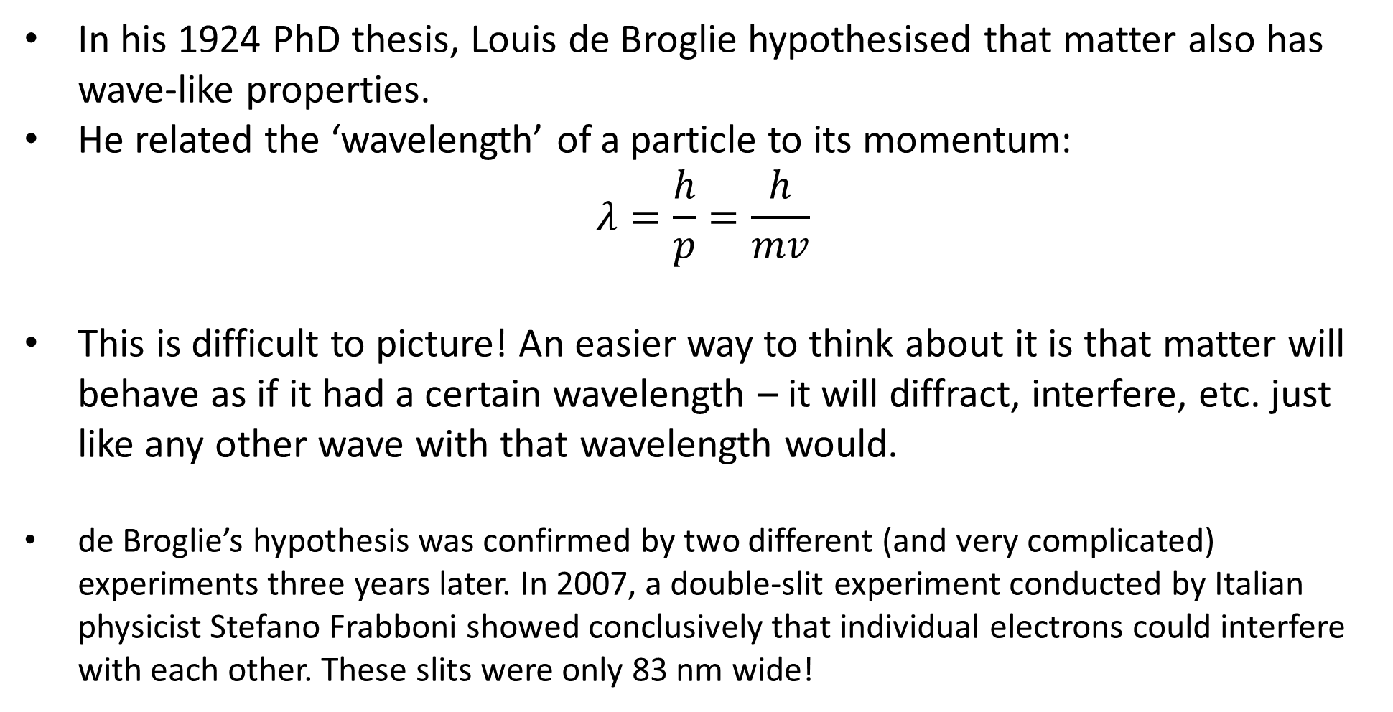
Matter Waves
In his 1924 PhD thesis, Louis de Broglie hypothesised that matter also has wave-like properties.
He related the ‘wavelength’ of a particle to its momentum:
$$λ=\frac{h}{p}=\frac{h}{mv}$$
This is difficult to picture! An easier way to think about it is that matter will behave as if it had a certain wavelength – it will diffract, interfere, etc. just like any other wave with that wavelength would.
de Broglie’s hypothesis was confirmed by two different (and very complicated) experiments three years later. In 2007, a double-slit experiment conducted by Italian physicist Stefano Frabboni showed conclusively that individual electrons could interfere with each other. These slits were only 83 nm wide!

Slide 4
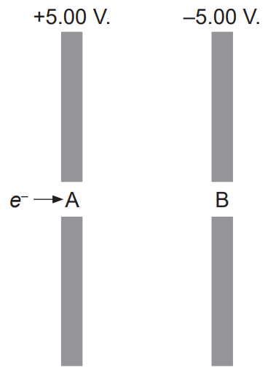
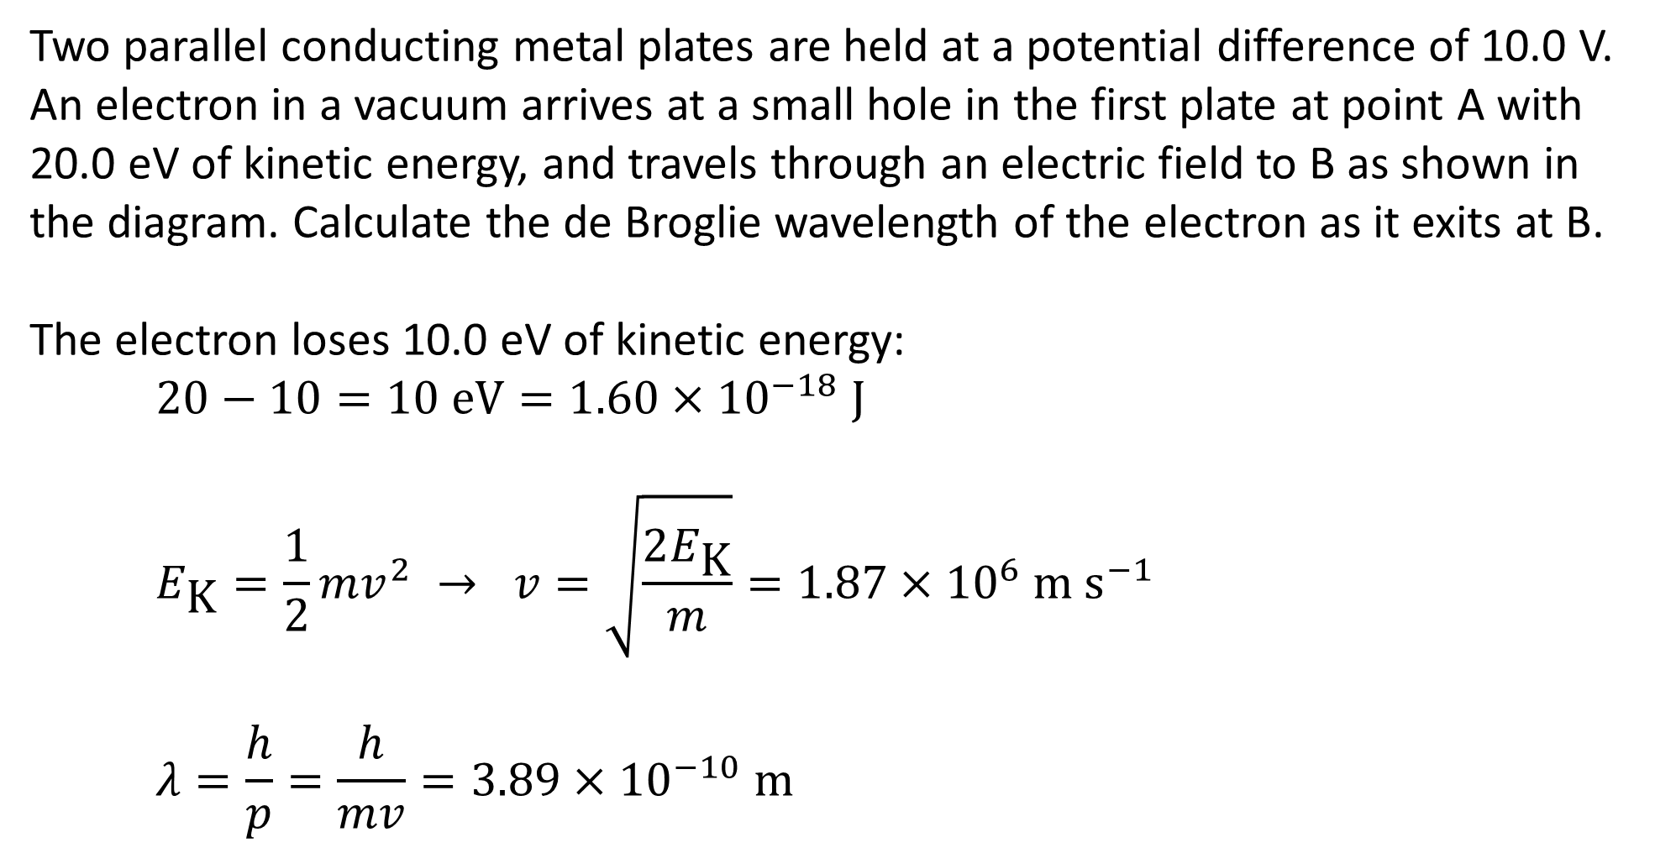
Example #1
Two parallel conducting metal plates are held at a potential difference of 10.0 V. An electron in a vacuum arrives at a small hole in the first plate at point A with 20.0 eV of kinetic energy, and travels through an electric field to B as shown in the diagram. Calculate the de Broglie wavelength of the electron as it exits at B.
The electron loses 10.0 eV of kinetic energy:
$$20−10=10 \text{eV}=1.60×{10}^{−18} \text{J}$$
$$E_{\text{K}}=\frac{1}{2}mv^{2} → v=\sqrt{\frac{2E_{\text{K}}}{m}}=1.87×{10}^{6} \text{m} {\text{s}}^{−1}$$
$$λ=\frac{h}{p}=\frac{h}{mv}=3.89×{10}^{−10} \text{m}$$
Notes:
This was a 5-mark WACE question in 2022. 1 mark for energy reduction, 1 for J conversion, 1 for v, 1 for 𝜆 working, 1 for final answer.

Slide 5
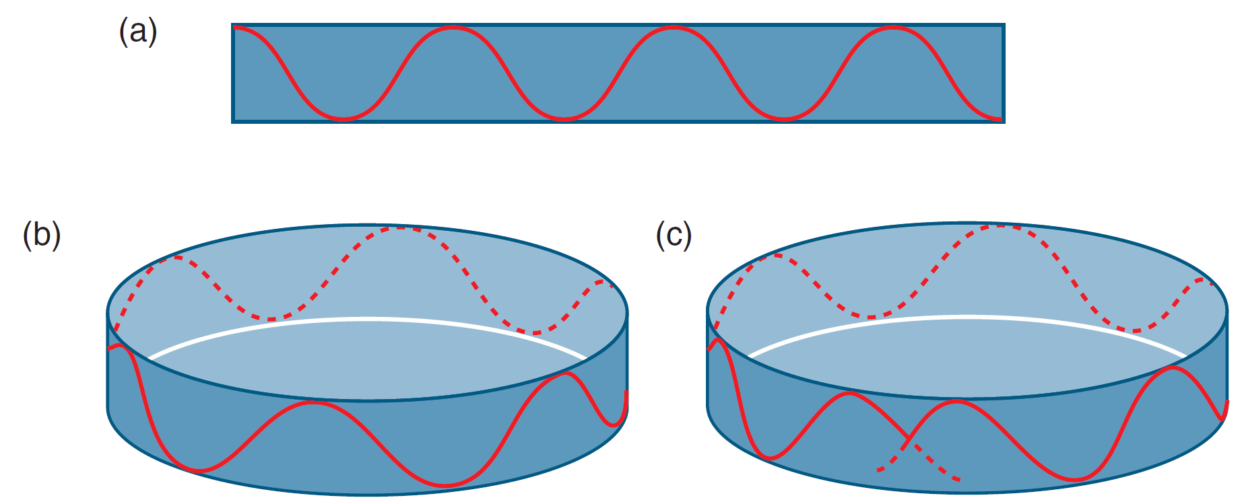
Matter Waves and Electron Orbitals
de Broglie then applied his idea of matter waves to Bohr’s model of the atom, suggesting that an electron could only stay at a given energy level if it established a standing wave.
(a) shows a simplified representation of an electron’s matter wave for a given velocity. If a whole number of wavelengths fits into a given circumference, an energy level may exist at that radius, as shown in (b). If not, destructive interference occurs and an energy level cannot form, as shown in (c).
This provided a physical explanation for one of Bohr’s major assumptions.

Slide 6
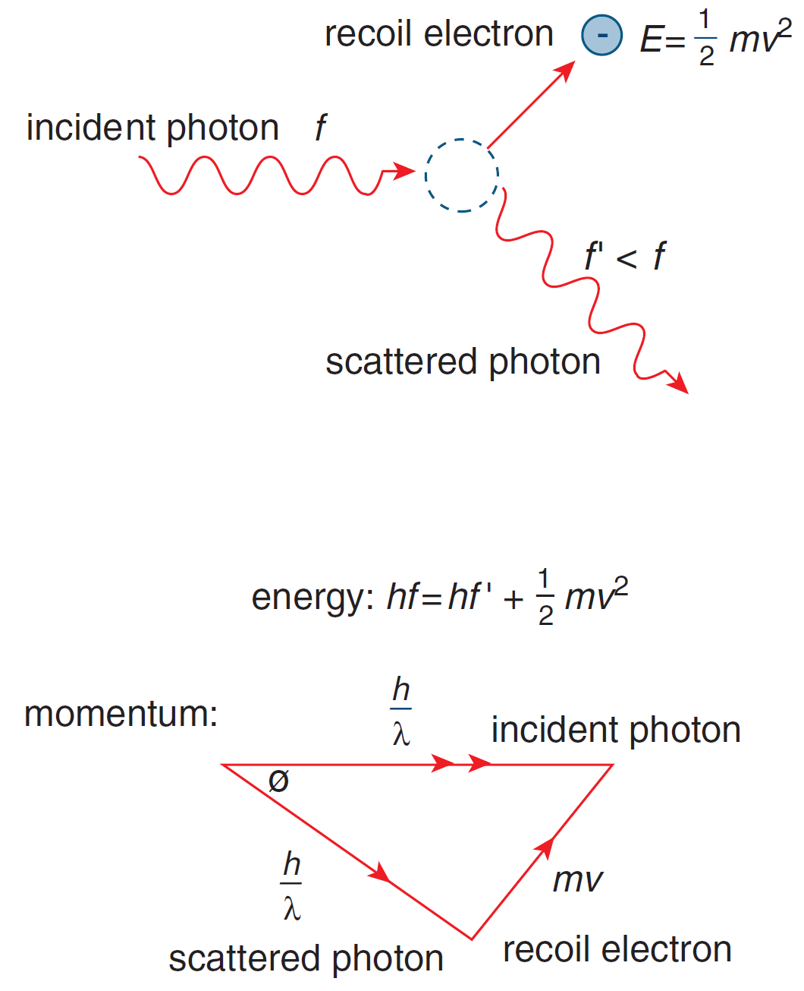
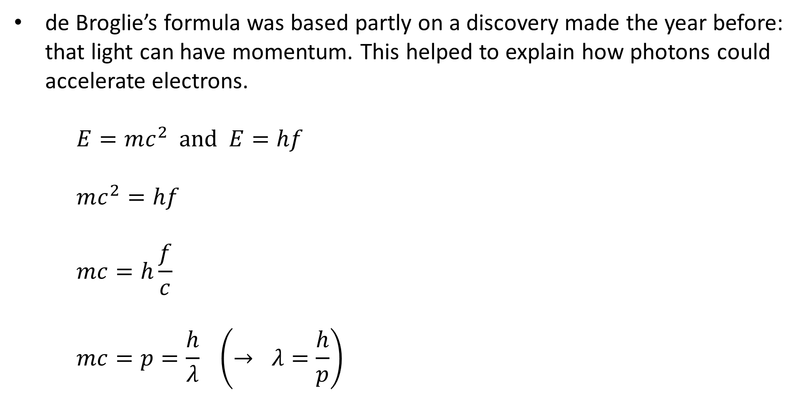
Photon Momentum
de Broglie’s formula was based partly on a discovery made the year before: that light can have momentum. This helped to explain how photons could accelerate electrons.
$$E=mc^{2} \text{and} E=hf$$
$$mc^{2}=hf$$
$$mc=h\frac{f}{c}$$
$$mc=p=\frac{h}{λ} \left(→ λ=\frac{h}{p}\right)$$
Notes:
p = mv works well for relatively large, slow objects, but not so well beyond that. A more general equation which relates energy, momentum and mass is E² = (pc)² + (mc²)², which works even for massless objects.

Slide 7
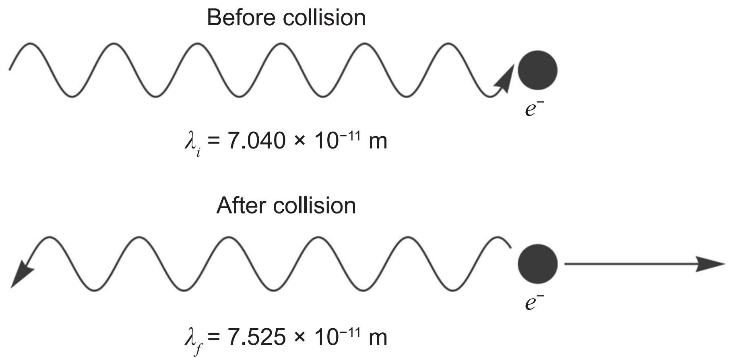
Example #2
A stationary free electron and a photon collide. In such collisions, both momentum and energy are conserved. In one such collision, a photon of wavelength 7.040 × 10^{–11} m is travelling in the direction shown in the diagram above. After the collision, the photon returns in the direction it came from (i.e. 180°) with a new wavelength of 7.525 × 10^{–11} m and the electron is no longer stationary. No other particles or photons are produced in the collision.
What is the original energy of the photon in eV?
What is the momentum of the photon before the collision?
Explain why the wavelength of the photon is greater after the collision.
Notes:
This was a 13-mark WACE question in 2022. 3 marks for part a (1.77 × 10⁴ eV), 2 for part b (9.42 × 10⁻²⁴ N s), 3 for part c (can use E = hc/𝜆 or 𝜆 = h/p)…

Slide 8
Example #2
A stationary free electron and a photon collide. In such collisions, both momentum and energy are conserved. In one such collision, a photon of wavelength 7.040 × 10^{–11} m is travelling in the direction shown in the diagram above. After the collision, the photon returns in the direction it came from (i.e. 180°) with a new wavelength of 7.525 × 10^{–11} m and the electron is no longer stationary. No other particles or photons are produced in the collision.
Calculate the speed of the electron after the collision. (Hint: use the principles of conservation of energy.)
Notes:
…and 5 for part d (2.00 × 10⁷ m s⁻¹).

